Slide 1
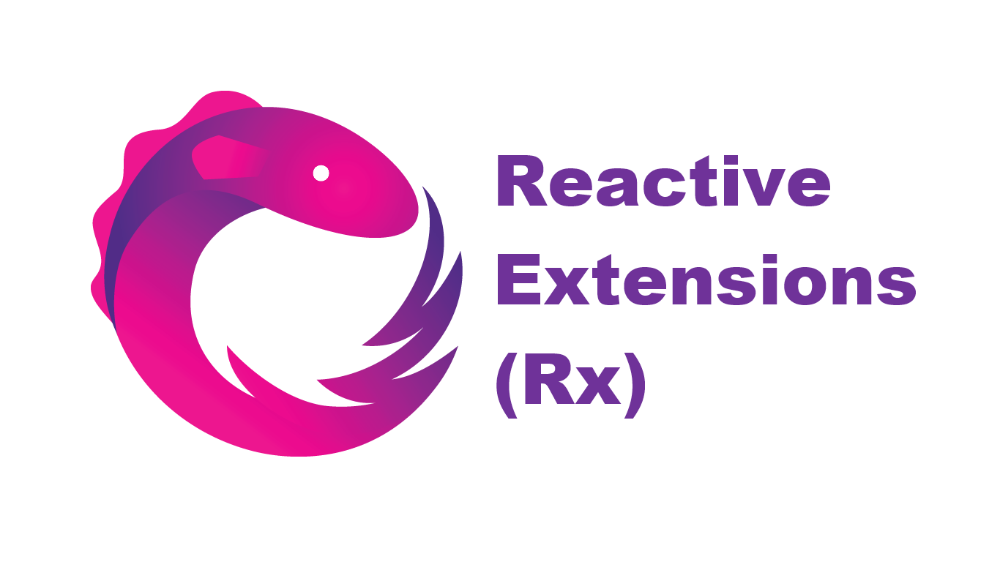
Reactive Solutions with Rx

Slide 2
Reactive Extensions (Rx)
Open source library from Microsoft
Observable sequences (IObservable interface)
LINQ-like queries
Learning resources:
http://reactivex.io/
http://www.introtorx.com/
https://github.com/Reactive-Extensions/Rx.NET

Slide 3
Case Study: Distributed Voting
E-Order system
Orders need to be validated by multiple parties (e.g. Credit Checker, Country Checker etc.) by casting a vote (Yes/No)
Validation is asynchronous
Validators can register in the validation engine with a subscription (with optional filter)
Votes must be cast within 2 seconds or they will not be counted
A voting result consists of all cast votes as well as the number of voters with a matching subscription

Slide 4
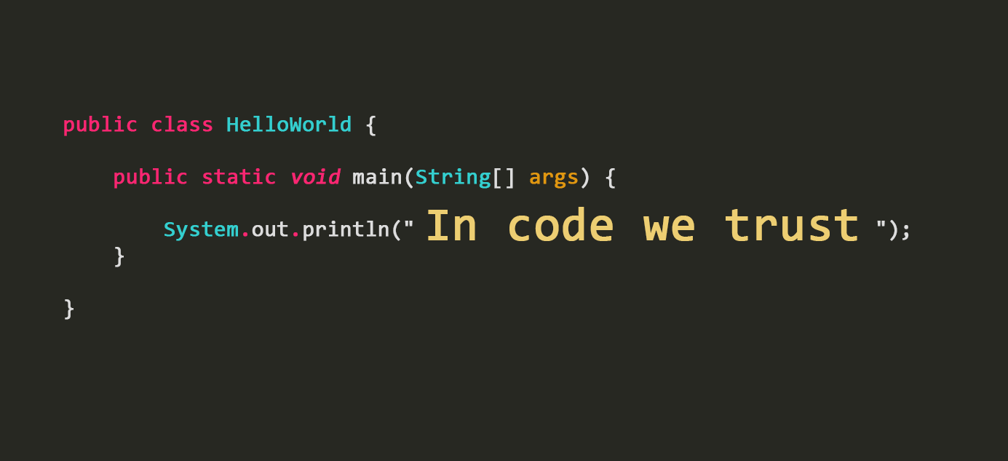
Coding Time

Slide 5

Thank you!

